Slide 1
Operation Hokey Pokey
Prototype. A car that uses computer vision to pick apart blocks of different characteristics.

Slide 2
Original Plan
Build a moving car that would scan a surface underneath it in a linear fashion and poke an object of choice
Servo and DC motors to move the car and poke the object. The object would be contrasted from the environment using fluorescent or bright colors
Use Arduino as our main control board and implement OpenCV computer vision library to detect and differentiate objects.

Slide 3
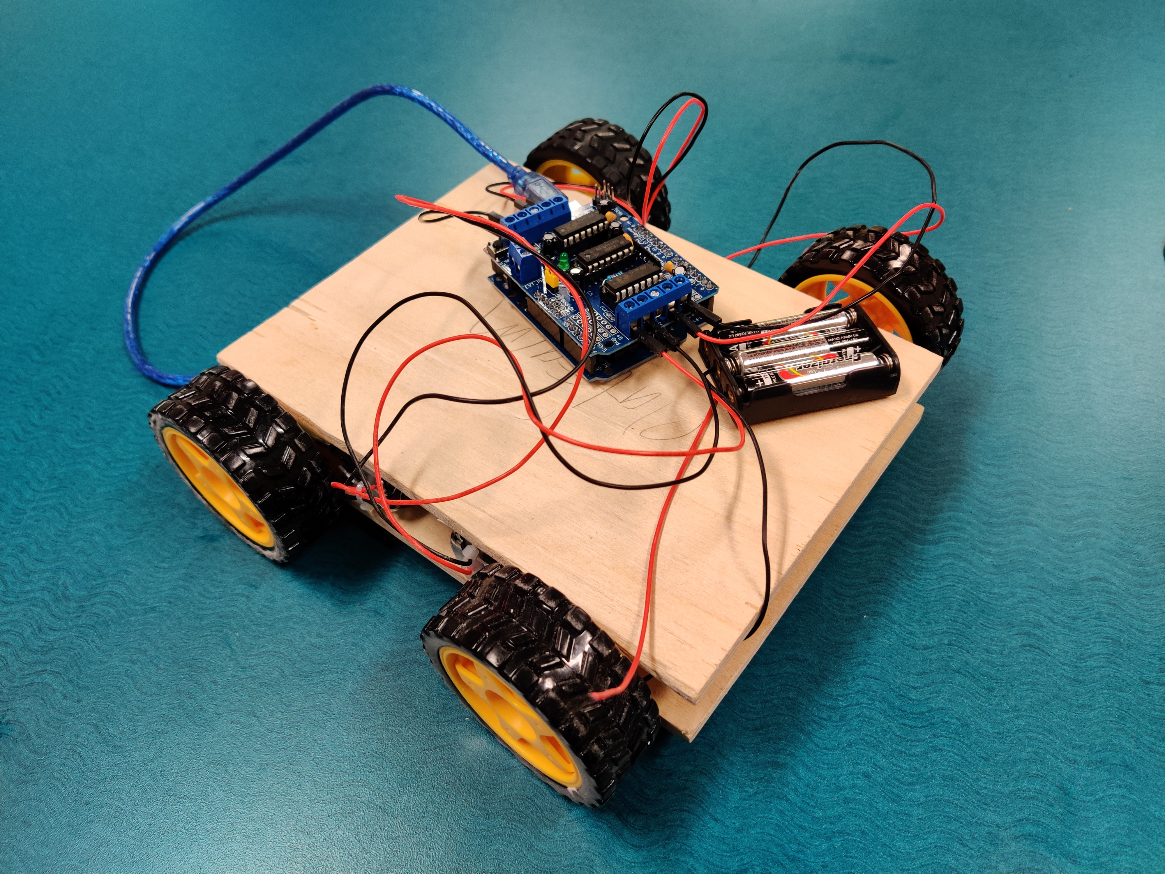
Our Current Progress
Progress:
1
Completed the track and we have cut out the basis for the car and its frame.
Have a functioning and moving car using Arduino and Arduino software. Car moves in a linear direction in two ways.
2
3
Researched OpenCV library and by extension the YOLO object detection algorithm.
4
Acquired all the hardware with the exception of the servo-motor for the poker and the camera.

Slide 4
Challenges so Far
Arduino was not capable of supporting all the connections to the four motors and one servo motor as well as the camera input.
FIX: purchased a motor shield capable of supporting everything it needed. This includes more inputs ports than the original Arduino.
Computer Vision: A very advanced topic and very difficult to learn within the given time frame and lack of sufficient time in our daily life. Also implementing the CV library to Arduino would have been rather difficult. Discovered several facial recognition programs that we would slightly manipulate to detect objects instead, which lead us to the YOLO object recognition algorithm. However we could not bridge the gap between Python and Arduino hardware since python would be the native language in which the OpenCV library would run on.
FIX: hardware-based solution given the time frame (more on this on the next slide).

Slide 5
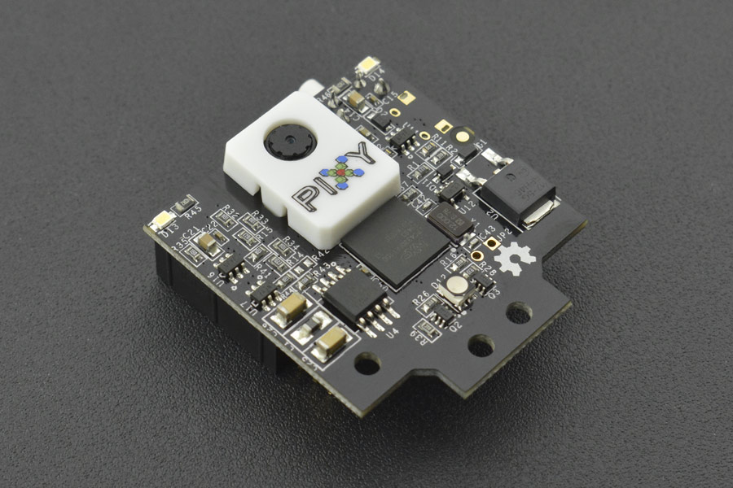
Changes
1
Motor Shield
Lack of Arduino Ports to sustain 6 modules
Chose Motor Shield over Bread Board because more compact and requires less wiring while performing the same function.
2
PIXY 2 Camera:
On-board Processor that performs object recognition by giving it images to Train.
With OpenCV, a separated python program would be needed which would take data from the Arduino Program, perform object detection, and send back more data to the Arduino Program. With PIXY, data is sent directly to the Arduino Program
More efficient and compatible with Arduino.

Slide 6
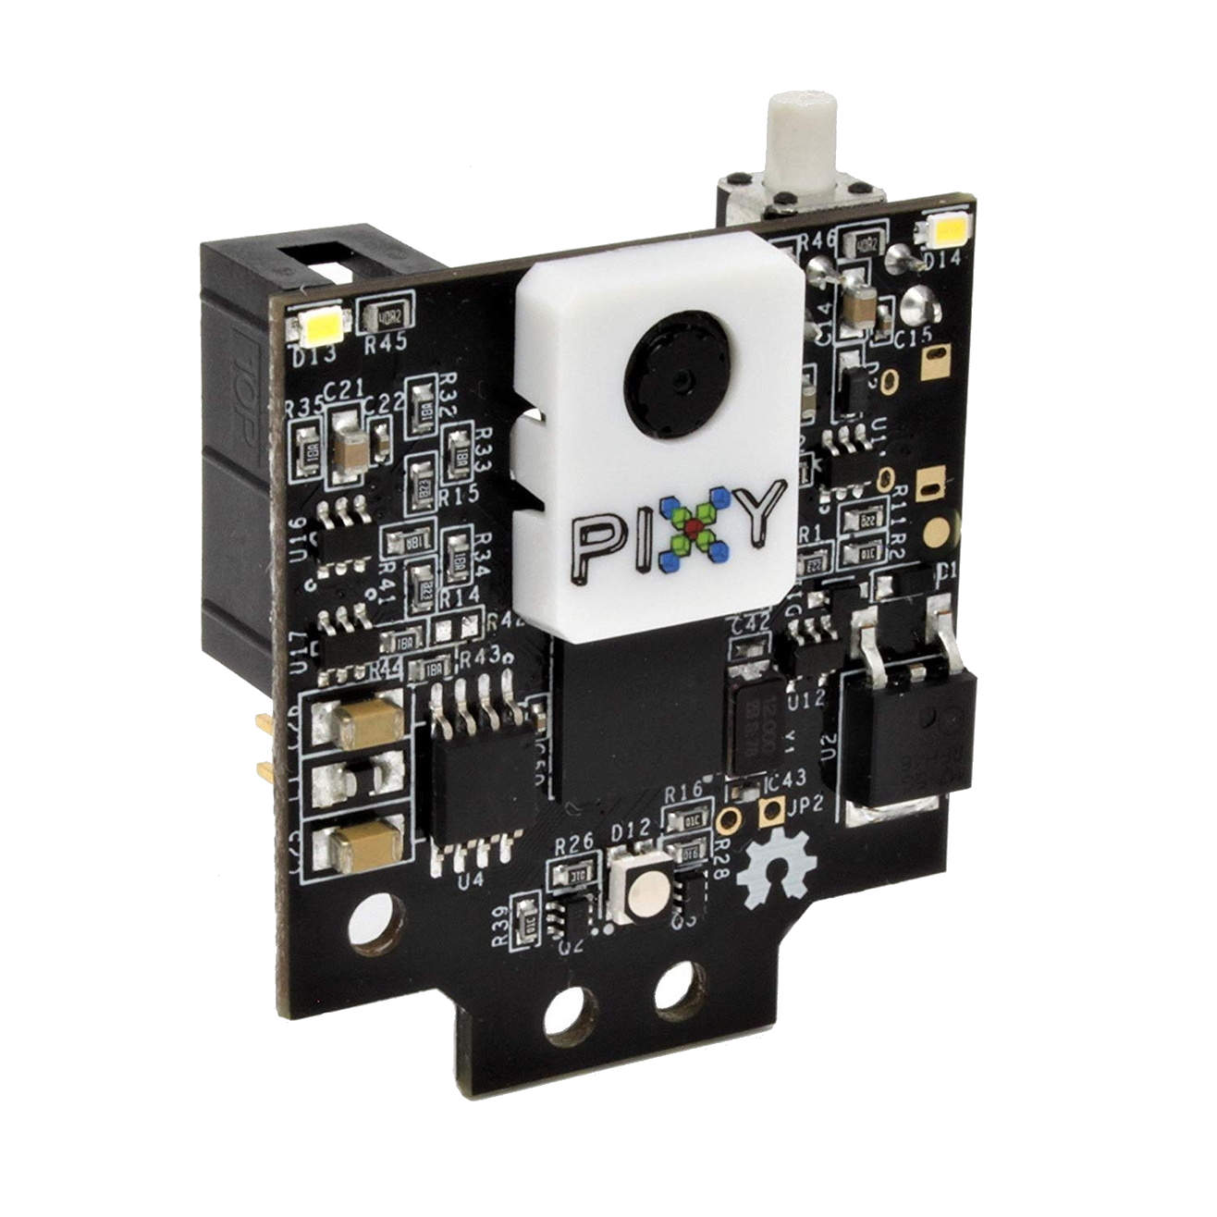
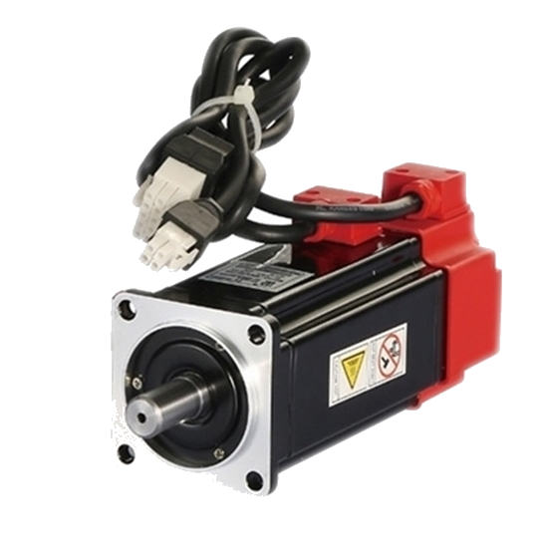
What is Left
Implement the PIXY 2 camera to the Arduino board and program it to be able to recognize blocks of different colour.
Build the poker and connect a servo motor the car that performs the poke function.
Implement the code that performs the decision making of the car on the Arduino program.

Slide 7
References
- https://www.dfrobot.com/product-1752.html

